Slide 1
Unconstrained
Optimization
Image Adhikari and Gobinda Pandey

Slide 2
Function 1: Quadratic Function
Gradient Descent
Steps: 85, Minimum f(x): 0.025517836989300404
Newton’s Method
Steps: 1, Minimum f(x): 0.0
Quasi-Newton (BFGS)
Steps: 73, Minimum f(x): 0.012437960354649402
Adam Optimizer
Steps: 3247, Minimum f(x): 0.026126965235065427
x_0 = np.ones(100)
alpha = 1.0
c = 0.1
rho = 0.5
max_iter = 1000 (8000 for Adam)
delta1 = 0.001 (0.0001 for Adam)
delta2 = 0.001 (0.0001 for Adam)

Slide 3
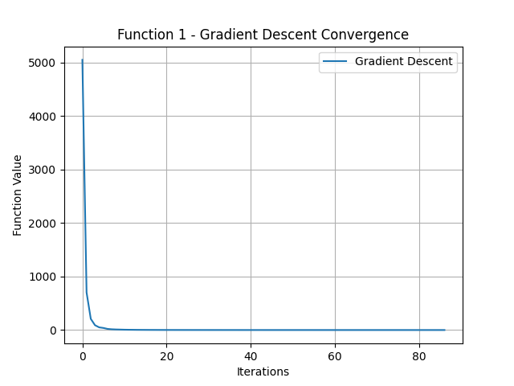
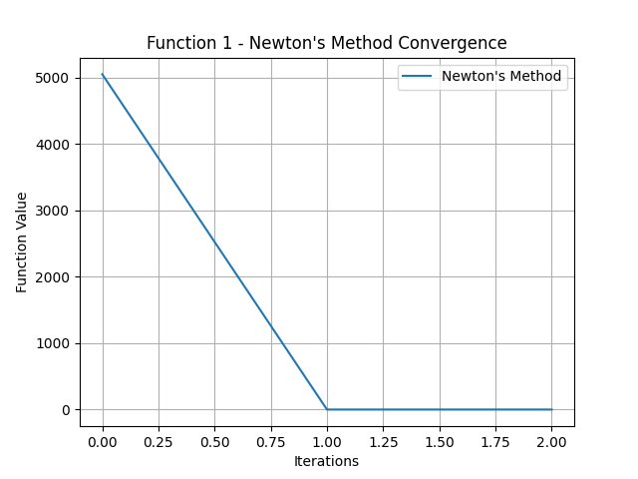
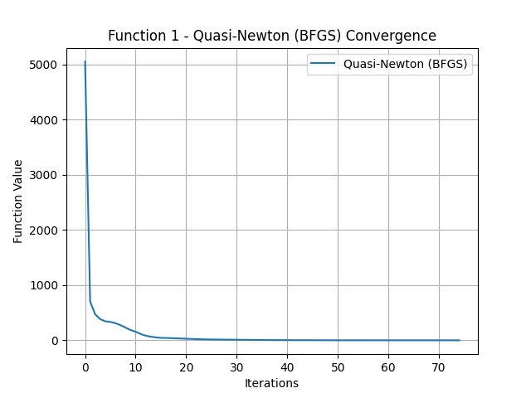
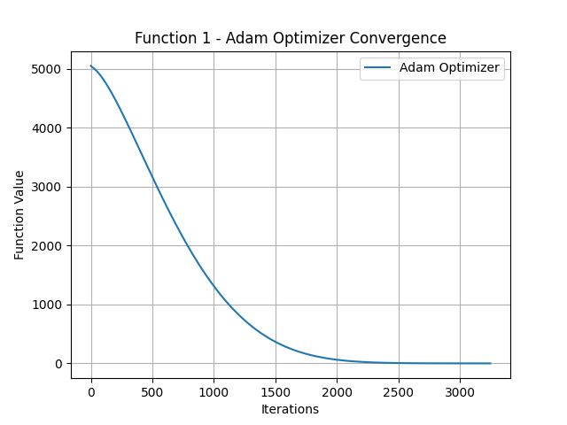

Slide 4
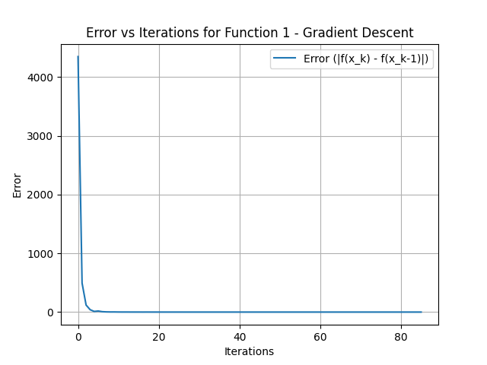
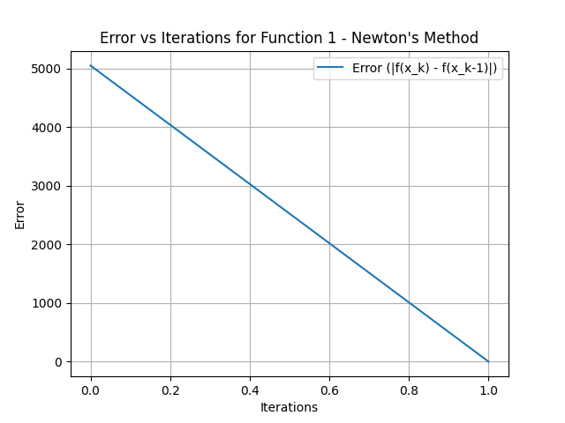
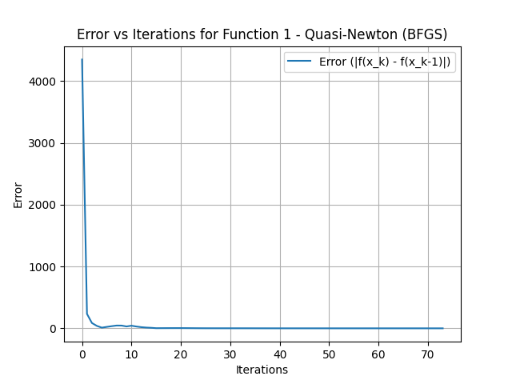
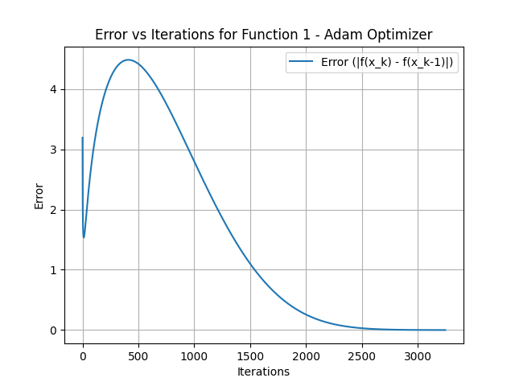

Slide 5
Function 1: Quadratic Function
Quadratic function with global minimum given f(x)_{min} = 0.
Newton’s method reached global minimum in single iteration since the function is quadratic.
Other methods were able to obtain functional values close to global minimum but not global minimum.
We used alpha = 1.0. Lowering the learning rate made reaching the global minimum slower.

Slide 6
Function 2: Log Barrier Function
Gradient Descent
Steps: 869, Minimum f(x): -2432.5626706206995
Newton’s Method
Steps: 8, Minimum f(x): -2432.866326777652
Quasi-Newton (BFGS)
Steps: 112, Minimum f(x): -2432.861446480478
Adam Optimizer
Steps: 8000, Minimum f(x): -2431.104760050882
x_0 = np.ones(100) * 0.01
alpha = 1.0
c = 0.1
rho = 0.5
max_iter = 1000 (8000 for Adam)
delta1 = 0.001 (0.0001 for Adam)
delta2 = 0.001 (0.0001 for Adam)

Slide 7
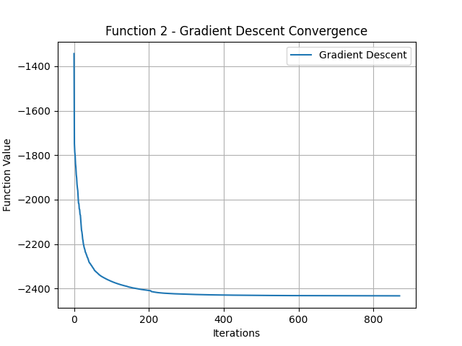
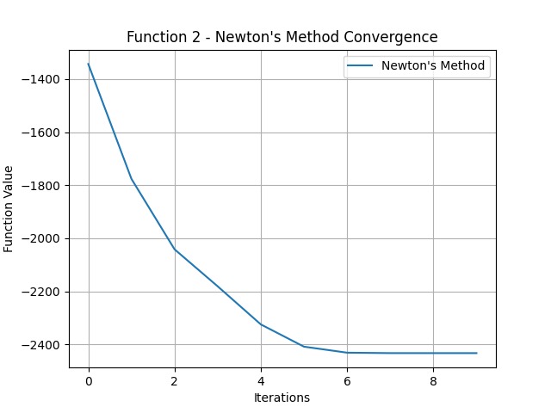
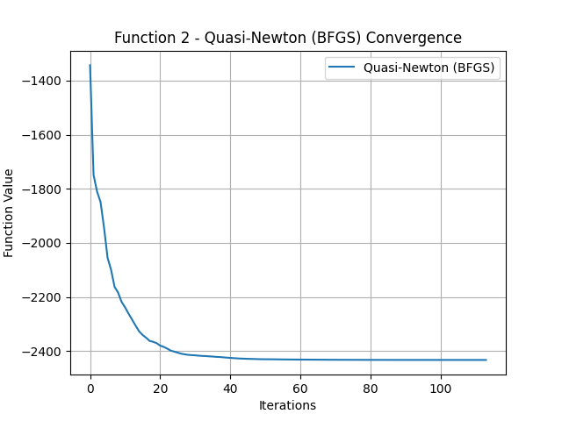
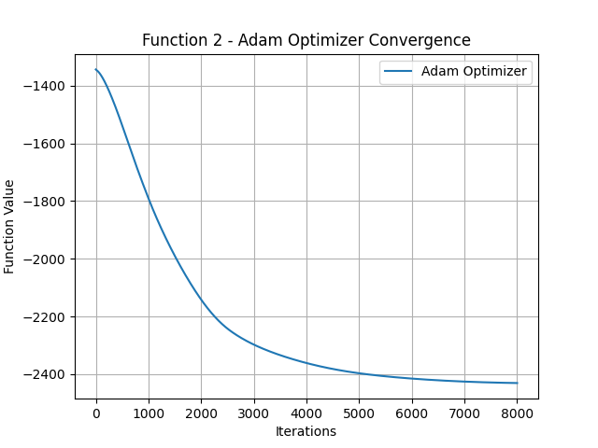

Slide 8
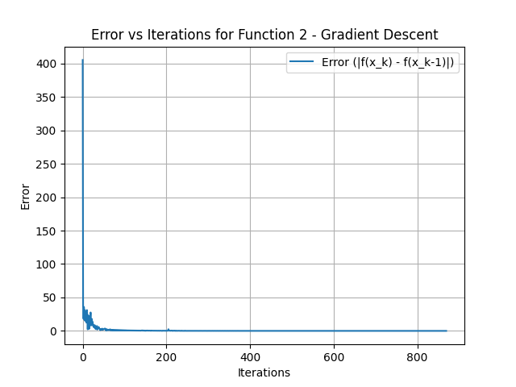
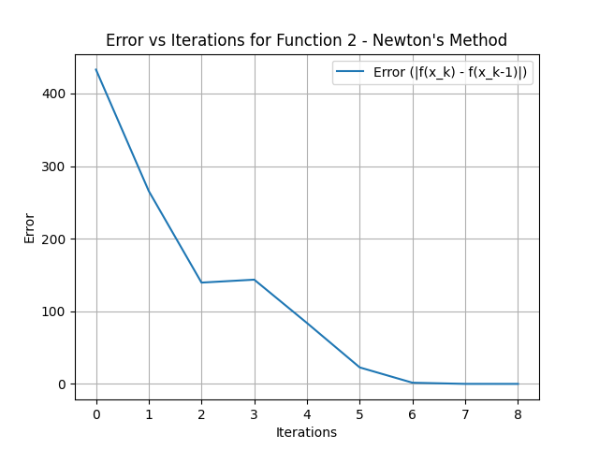
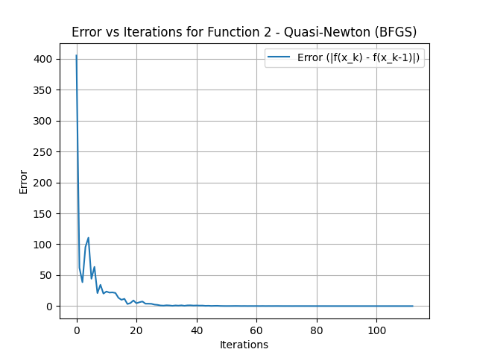
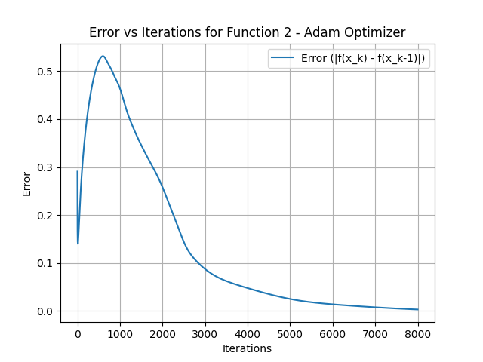

Slide 9
Function 2: Log Barrier Function
High dimensional function
We had a domain restriction
b_{i} - a_{i}^{T}x > 0
To satisfy the domain, we defined the function in a way that it returns a very large value whenever x + alpha * p results in any value where b_{i} - a_{i}^{T}x is non-positive.
Gradient descent had a slow convergence rate for the large dimensional function.
Newton’s method was the fastest followed by quasi-newton.
Minimum functional values for all methods was similar.

Slide 10
Function 3: Bi-quadratic (Rosenbrock) Function
x_0 = np.array([2.0, 2.0])
alpha = 1.0
c = 0.1
rho = 0.5
max_iter = 1000 (8000 for Adam)
delta1 = 0.001 (0.0001 for Adam)
delta2 = 0.001 (0.0001 for Adam)
Gradient Descent
Steps: 3, Minimum f(x): 0.1997655255915457
Newton’s Method
Steps: 11, Minimum f(x): 2.430697658828909e-05
Quasi-Newton (BFGS)
Steps: 5, Minimum f(x): 0.053686336330168706
Adam Optimizer
Steps: 1474, Minimum f(x): 0.7850856229011988

Slide 11
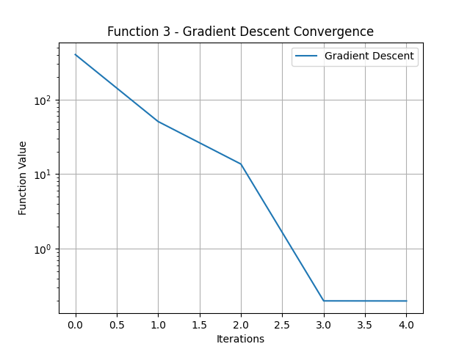
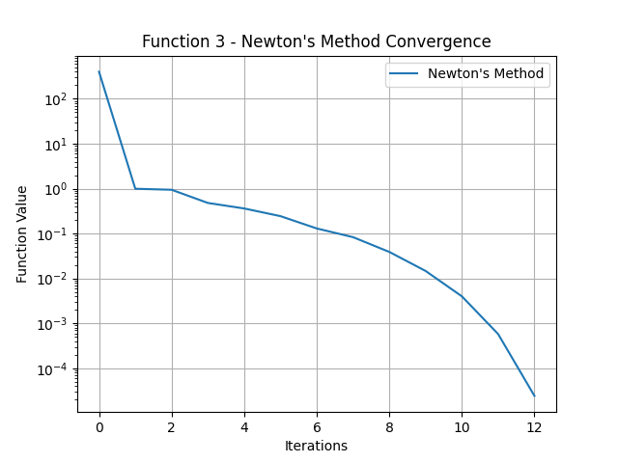
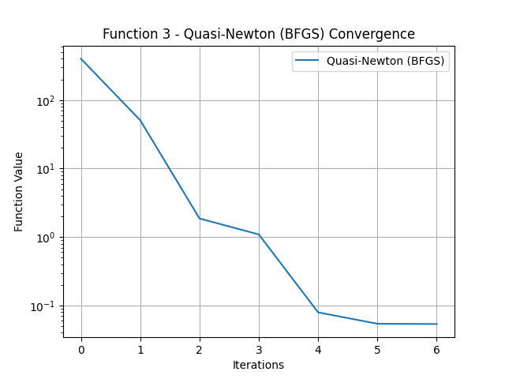
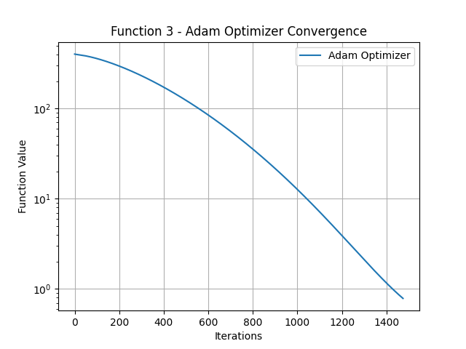

Slide 12
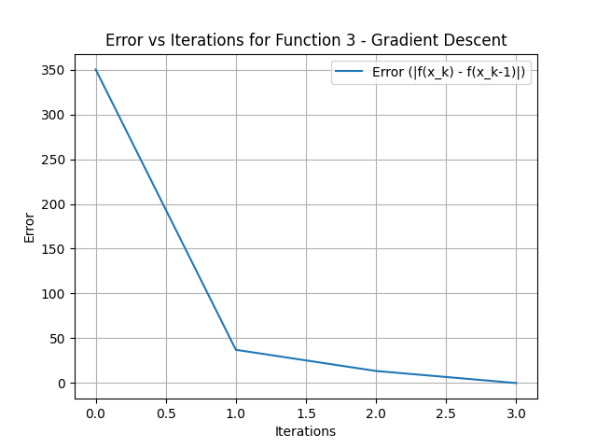
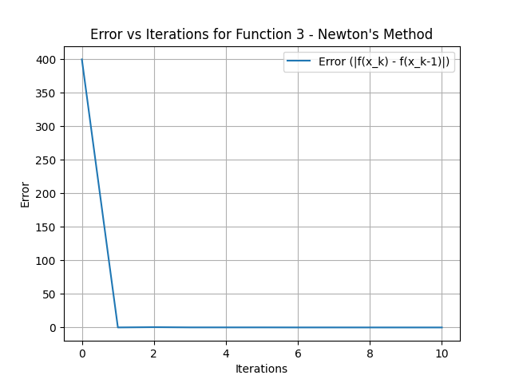
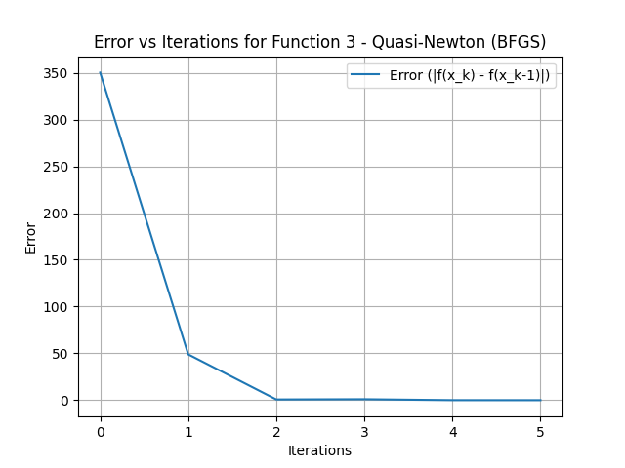
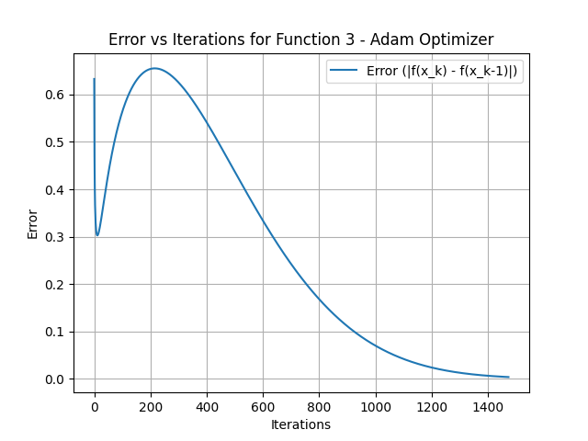

Slide 13
Function 3: Bi-quadratic (Rosenbrock) Function
Polynomial function of order 4
Gradient descent method satisfies the stopping criteria very soon and fails to reach the global minimum.
Newton’s method reached very close to the optimum function value i.e. 0 and quasi newton was also close to this.

Slide 14
Optional Method: Adam Optimizer
Overall Observations:
Iterative Efficiency: Require more iterations contradicting initial assumption of faster convergence
Minimum values: Not similar to other methods, raising questions about its efficiency in this specific context
Implication of Results: Though being robust and capable of handling complex optimisation tasks, may not always meet expectations particularly in certain function landscapes

Slide 15
Adam
Initialization: m = 0 (first moment estimate), v = 0(second moment estimate)
Gradient Calculation: Calculate the gradient as before: ∇f(x)
Update Moments:
First Moment: m = β₁m+(1−β₁)∇f(x), where β₁ is typically around 0.9.
Second Moment: v = β₂v+(1−β₂)(∇f(x))², with β₂ usually around 0.999.
Bias Correction: Since m and v are initialized to zero, we apply bias correction: m_hat = m / (1−β₁^{t}) , v_hat = v / (1−β₂^{t})
Update Step: The parameter update is given by: x_new = x - (α / (√v_hat + ε)) * m_hat where α is the base learning rate and ϵ is a small constant to prevent division by zero.

Slide 16
Thank You

